Slide 1
Compositing and Blending
Ed Angel
Professor of Computer Science, Electrical and Computer Engineering, and Media Arts
University of New Mexico

Slide 2
Objectives
Learn to use the A component in RGBA color for
  Blending for translucent surfaces
  Compositing images
  Antialiasing
Angel: Interactive Computer Graphics 5E © Addison-Wesley 2009

Slide 3

Opacity and Transparency
Opaque surfaces permit no light to pass through
Transparent surfaces permit all light to pass
Translucent surfaces pass some light
translucency = 1 – opacity (α)
opaque surface α =1
Angel: Interactive Computer Graphics 5E © Addison-Wesley 2009

Slide 4
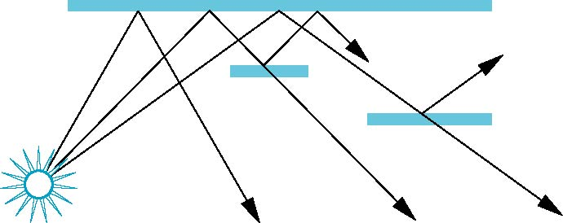
Physical Models
Dealing with translucency in a physically correct manner is difficult due to
  the complexity of the internal interactions of light and matter
  Using a pipeline renderer
Angel: Interactive Computer Graphics 5E © Addison-Wesley 2009

Slide 5
Writing Model
Use A component of RGBA (or RGBα) color to store opacity
During rendering we can expand our writing model to use RGBA values
blend
source blending factor
source
component
destination
component
destination blending
factor
Color Buffer
Angel: Interactive Computer Graphics 5E © Addison-Wesley 2009

Slide 6
Blending Equation
We can define source and destination blending factors for each RGBA component
s = [s_{r}, s_{g}, s_{b}, s_{α}]
d = [d_{r}, d_{g}, d_{b}, d_{α}]
Suppose that the source and destination colors are
b = [b_{r}, b_{g}, b_{b}, b_{α}]
c = [c_{r}, c_{g}, c_{b}, c_{α}]
Blend as
c’ = [b_{r} s_{r}+ c_{r} d_{r}, b_{g} s_{g}+ c_{g} d_{g} , b_{b} s_{b}+ c_{b} d_{b} , b_{α} s_{α}+ c_{α} d_{α} ]
Angel: Interactive Computer Graphics 5E © Addison-Wesley 2009

Slide 7
OpenGL Blending and Compositing
Must enable blending and pick source and destination factors
glEnable(GL_BLEND)
glBlendFunc(source_factor,
destination_factor)
Only certain factors supported
  GL_ZERO, GL_ONE
  GL_SRC_ALPHA, GL_ONE_MINUS_SRC_ALPHA
  GL_DST_ALPHA, GL_ONE_MINUS_DST_ALPHA
  See Redbook for complete list
Angel: Interactive Computer Graphics 5E © Addison-Wesley 2009

Slide 8
Example
Suppose that we start with the opaque background color (R₀,G₀,B₀,1)
  This color becomes the initial destination color
We now want to blend in a translucent polygon with color (R₁,G₁,B₁,α₁)
Select GL_SRC_ALPHA and GL_ONE_MINUS_SRC_ALPHA as the source and destination blending factors
R’₁ = α₁ R₁ +(1- α₁) R_{0,} ……
Note this formula is correct if polygon is either opaque or transparent
Angel: Interactive Computer Graphics 5E © Addison-Wesley 2009

Slide 9
Clamping and Accuracy
All the components (RGBA) are clamped and stay in the range (0,1)
However, in a typical system, RGBA values are only stored to 8 bits
  Can easily loose accuracy if we add many components together
  Example: add together n images
    Divide all color components by n to avoid clamping
    Blend with source factor = 1, destination factor = 1
    But division by n loses bits
Angel: Interactive Computer Graphics 5E © Addison-Wesley 2009

Slide 10
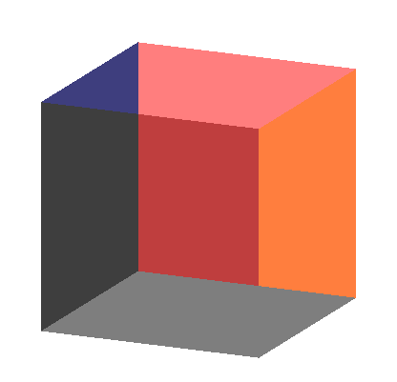
Order Dependency
Is this image correct?
  Probably not
  Polygons are rendered
  in the order they pass
  down the pipeline
  Blending functions
  are order dependent
Angel: Interactive Computer Graphics 5E © Addison-Wesley 2009

Slide 11
Opaque and Translucent Polygons
Suppose that we have a group of polygons some of which are opaque and some translucent
How do we use hidden-surface removal?
Opaque polygons block all polygons behind them and affect the depth buffer
Translucent polygons should not affect depth buffer
  Render with glDepthMask(GL_FALSE) which makes depth buffer read-only
Sort polygons first to remove order dependency
Angel: Interactive Computer Graphics 5E © Addison-Wesley 2009

Slide 12
Fog
We can composite with a fixed color and have the blending factors depend on depth
  Simulates a fog effect
Blend source color C_{s} and fog color C_{f} by
C_{s}’=f C_{s} + (1-f) C_{f}
f is the fog factor
  Exponential
  Gaussian
  Linear (depth cueing)
Angel: Interactive Computer Graphics 5E © Addison-Wesley 2009

Slide 13
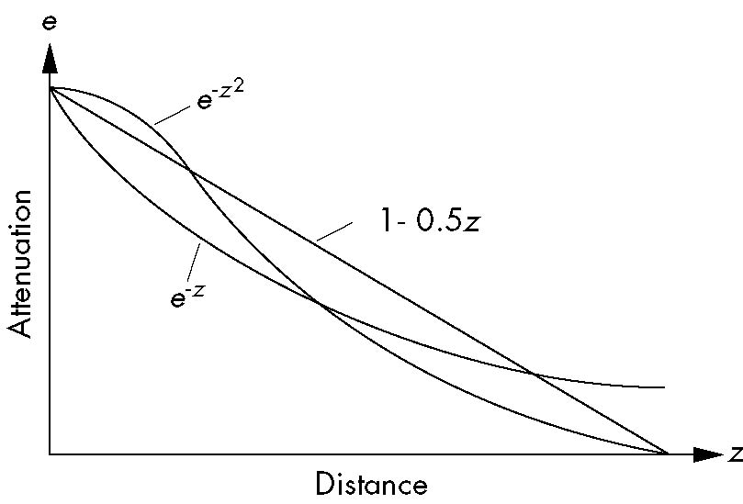
Fog Functions
Angel: Interactive Computer Graphics 5E © Addison-Wesley 2009

Slide 14
OpenGL Fog Functions
GLfloat fcolor[4] = {……}:
glEnable(GL_FOG);
glFogf(GL_FOG_MODE, GL_EXP);
glFogf(GL_FOG_DENSITY, 0.5);
glFOgv(GL_FOG, fcolor);
Angel: Interactive Computer Graphics 5E © Addison-Wesley 2009

Slide 15
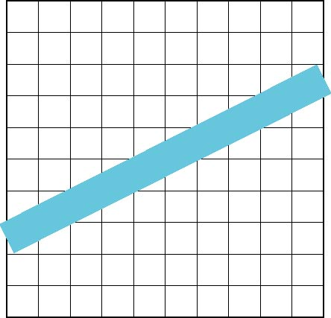
Line Aliasing
Ideal raster line is one pixel wide
All line segments, other than vertical and horizontal segments, partially cover pixels
Simple algorithms color
only whole pixels
Lead to the “jaggies”
or aliasing
Similar issue for polygons
Angel: Interactive Computer Graphics 5E © Addison-Wesley 2009

Slide 16
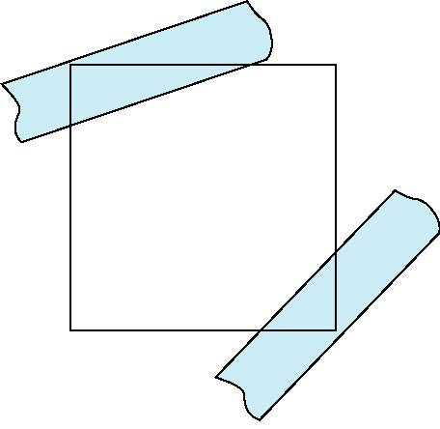
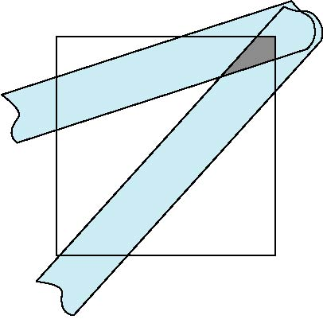
Antialiasing
Can try to color a pixel by adding a fraction of its color to the frame buffer
  Fraction depends on percentage of pixel covered by fragment
  Fraction depends on whether there is overlap
no overlap
overlap
Angel: Interactive Computer Graphics 5E © Addison-Wesley 2009

Slide 17
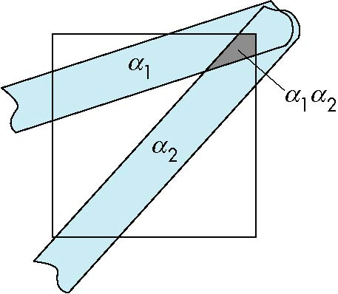
Area Averaging
Use average area α₁+α₂-α₁α₂ as blending factor
Angel: Interactive Computer Graphics 5E © Addison-Wesley 2009

Slide 18
OpenGL Antialiasing
Can enable separately for points, lines, or polygons
glEnable(GL_POINT_SMOOTH);
glEnable(GL_LINE_SMOOTH);
glEnable(GL_POLYGON_SMOOTH);
glEnable(GL_BLEND);
glBlendFunc(GL_SRC_ALPHA, GL_ONE_MINUS_SRC_ALPHA);
Angel: Interactive Computer Graphics 5E © Addison-Wesley 2009

Slide 19
Accumulation Buffer
Compositing and blending are limited by resolution of the frame buffer
  Typically 8 bits per color component
The accumulation buffer is a high resolution buffer (16 or more bits per component) that avoids this problem
Write into it or read from it with a scale factor
Slower than direct compositing into the frame buffer
Angel: Interactive Computer Graphics 5E © Addison-Wesley 2009

Slide 20
Applications
Compositing
Image Filtering (convolution)
Whole scene antialiasing
Motion effects
Angel: Interactive Computer Graphics 5E © Addison-Wesley 2009

